Slide 1

Boolean Algebra
Boolean Logic and Truth Tables – the secret life of systems, computers and you

Slide 2

Objectives
Students should be able to
Be familiar with the use of Boolean identities and
De Morgan’s laws to manipulate and simplify Boolean expressions.

Slide 3
Revision 5 Minutes Activity
Complete the tasks on the Revision sheet
Record answers on the board

Slide 4
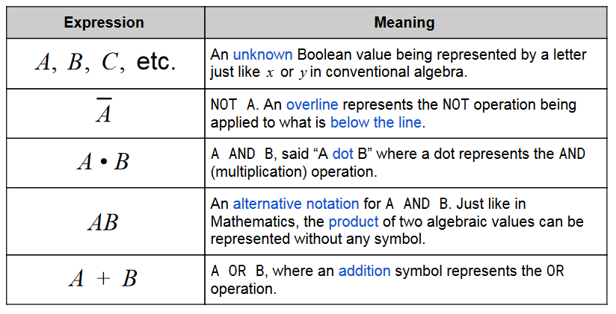
Boolean Algebra
Just like algebra in Mathematics, Boolean algebra concerns representing values with letters and simplifying expressions.
Boolean algebra uses the Boolean values TRUE and FALSE which can be represented as 1 and 0 respectively
Notation

Slide 5
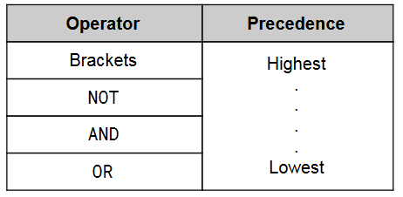
Order of Precedence
Algebraic operations have an order of precedence, meaning that some operations must be
applied before others.
The order of preference is BODMAS just like in Mathematics.
For example, the expression B OR NOT C AND A would actually be carried out in the order B OR ((NOT C) AND A).

Slide 6
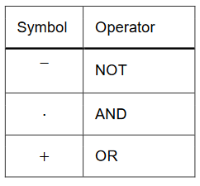
BOOLEAN ALGEBRA OPERATORS
Boolean expressions often use symbols for the operators.
Different symbols can be used, but FOR CIE examination the following will be used at all times
In Boolean algebra, parts of a statement are often given a single letter. This means we can write our statement as:
C = ((B ) (V + R))
Using the order of preference, the NOT statement will be evaluated first, so we can simplify our statement slightly by removing the brackets:
C = B(V + R)

Slide 7
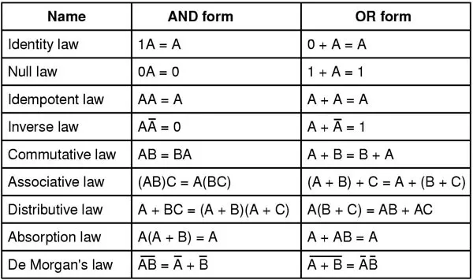
Boolean Laws
There are a number of useful Boolean rules/laws that can be used to simplify Boolean expressions

Slide 8
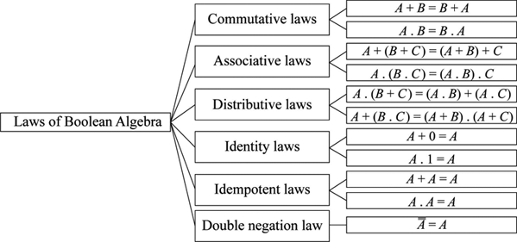
Boolean Laws
There are a number of useful Boolean rules/laws that can be used to simplify Boolean expressions

Slide 9
Complement Law
A complement of an element is its opposite.
In Boolean logic, the complement of any element A is A (NOT A).
The complement of the binary value 1 is 0. The complement of the value True is False. Complement laws state that each element has a complement to itself and that operating an
a) A + A = 1 b) A . A = 0
A | A | A.A
1 | 0 | 1
1 | 0 | 1
A | A | A.A
1 | 0 | 1
1 | 0 | 1

Slide 10

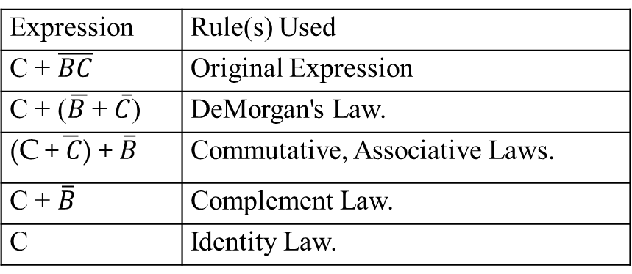
Laws of Boolean logic
Simplify: C + $\overline{BC}$
Expression | Rule(s) Used
C + $\overline{BC}$ | Original Expression
C + ($\overline{B }$+ $\overline{C}$) | DeMorgan's Law.
(C +$\overline{ C}$) + $\overline{B}$ | Commutative, Associative Laws.
C + $\overline{B}$ | Complement Law.
C | Identity Law.
Notes:
http://sandbox.mc.edu/~bennet/cs110/boolalg/simple.html

Slide 11
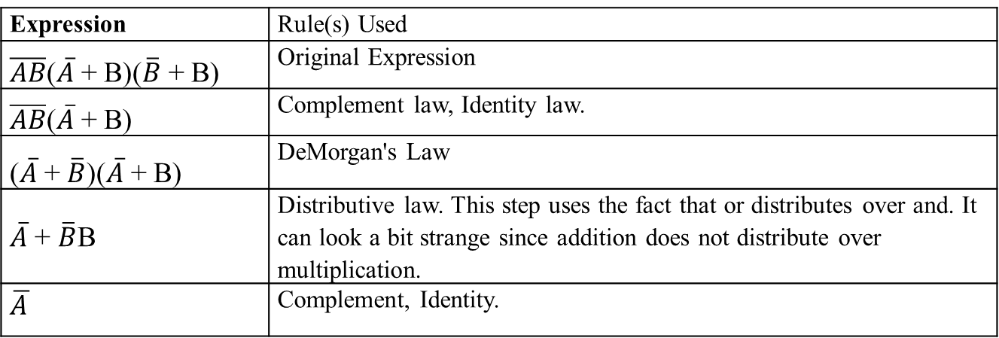

Working Example
Simplify: $\overline{AB}$($\overline{A}$ + B)($\overline{B}$ + B)
Expression | Rule(s) Used
$\overline{AB}$($\overline{A}$ + B)($\overline{B}$ + B) | Original Expression
$\overline{AB}$($\overline{A}$ + B) | Complement law, Identity law.
($\overline{A}$ + $\overline{B}$)($\overline{A}$ + B) | DeMorgan's Law
$\overline{A}$ + $\overline{B}$B | Distributive law. This step uses the fact that or distributes over and. It can look a bit strange since addition does not distribute over multiplication.
$$\overline{A }$$ | Complement, Identity.

Slide 12

Plenary Quiz

Slide 13
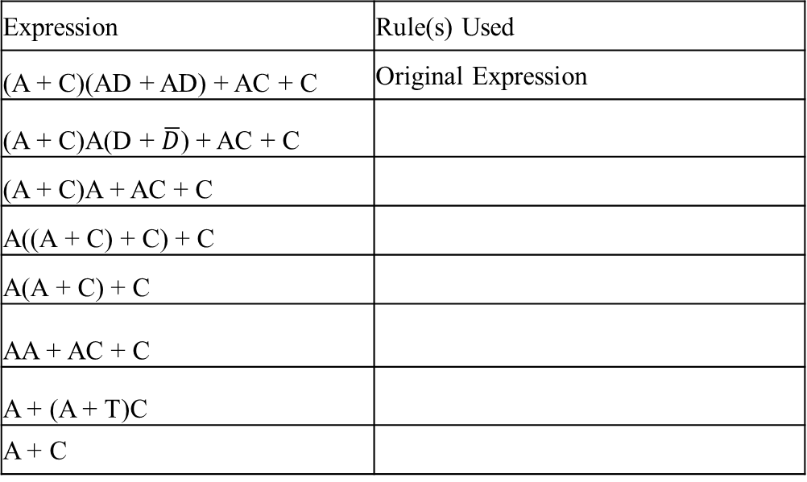
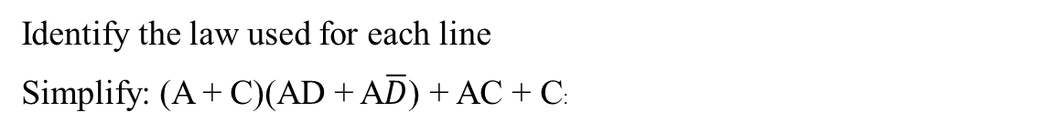
Test your knowledge
Identify the law used for each line
Simplify: (A + C)(AD + A$\overline{D}$) + AC + C:
Expression | Rule(s) Used
(A + C)(AD + AD) + AC + C | Original Expression
(A + C)A(D + $\overline{D}$) + AC + C
(A + C)A + AC + C
A((A + C) + C) + C
A(A + C) + C
AA + AC + C
A + (A + T)C
A + C

Slide 14
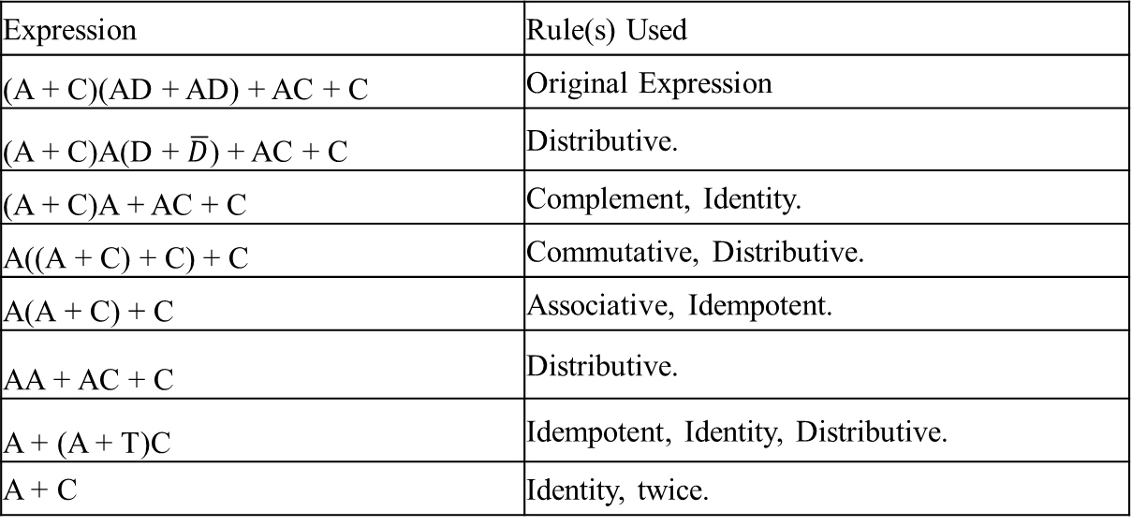
Solution Example
Simplify: (A + C)(AD + A$\overline{D}$) + AC + C:
Expression | Rule(s) Used
(A + C)(AD + AD) + AC + C | Original Expression
(A + C)A(D + $\overline{D}$) + AC + C | Distributive.
(A + C)A + AC + C | Complement, Identity.
A((A + C) + C) + C | Commutative, Distributive.
A(A + C) + C | Associative, Idempotent.
AA + AC + C | Distributive.
A + (A + T)C | Idempotent, Identity, Distributive.
A + C | Identity, twice.

Slide 15
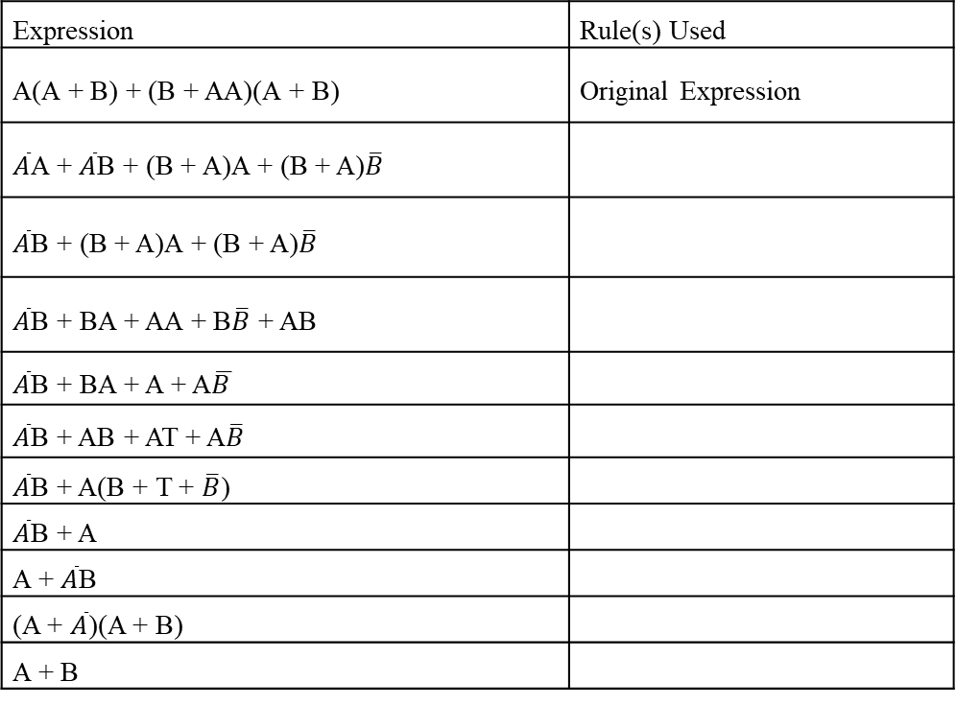
Test your knowledge
Simplify: $\overline{A}$(A + B) + (B + AA)(A + $\overline{B}$)
Expression | Rule(s) Used
A(A + B) + (B + AA)(A + B) | Original Expression
$\overline{A}$A + $\overline{A}$B + (B + A)A + (B + A)$\overline{B}$
$\overline{A}$B + (B + A)A + (B + A)$\overline{B}$
$\overline{A}$B + BA + AA + B$\overline{B}$ + AB
$\overline{A}$B + BA + A + A$\overline{B }$
$\overline{A}$B + AB + AT + A$\overline{B}$
$\overline{A}$B + A(B + T + $\overline{B}$)
$\overline{A}$B + A
A + $\overline{A}$B
(A + $\overline{A}$)(A + B)
A + B

Slide 16
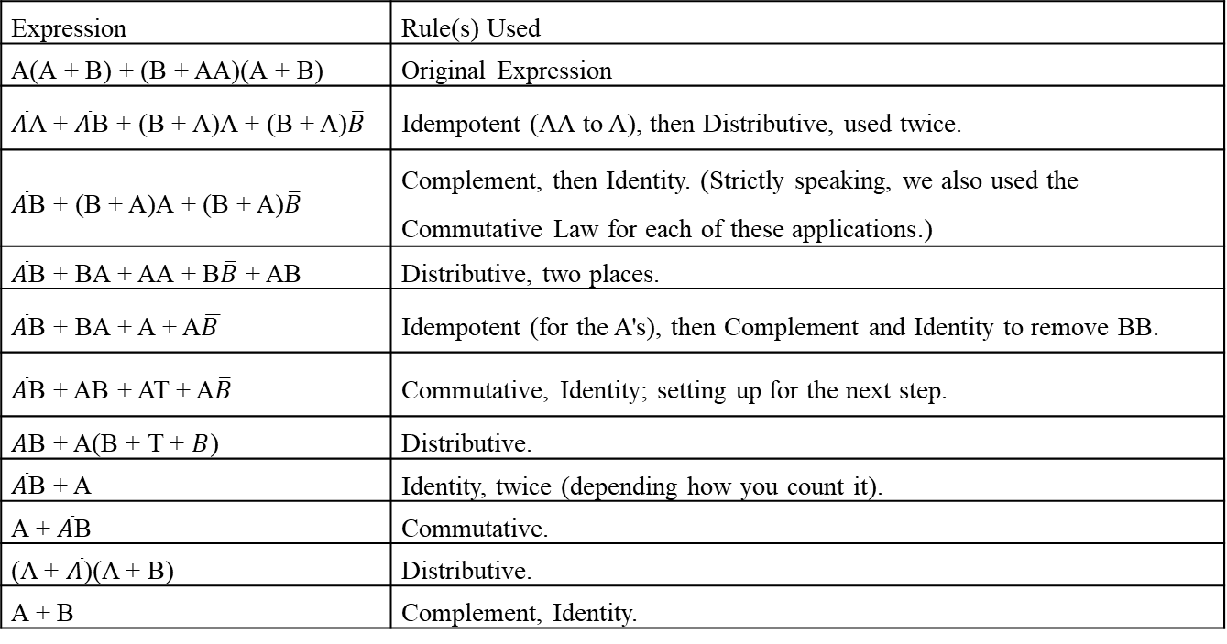
Solution Example
Simplify: $\overline{A}$(A + B) + (B + AA)(A + $\overline{B}$)
Expression | Rule(s) Used
A(A + B) + (B + AA)(A + B) | Original Expression
$\overline{A}$A + $\overline{A}$B + (B + A)A + (B + A)$\overline{B}$ | Idempotent (AA to A), then Distributive, used twice.
$\overline{A}$B + (B + A)A + (B + A)$\overline{B}$ | Complement, then Identity. (Strictly speaking, we also used the Commutative Law for each of these applications.)
$\overline{A}$B + BA + AA + B$\overline{B}$ + AB | Distributive, two places.
$\overline{A}$B + BA + A + A$\overline{B }$ | Idempotent (for the A's), then Complement and Identity to remove BB.
$\overline{A}$B + AB + AT + A$\overline{B}$ | Commutative, Identity; setting up for the next step.
$\overline{A}$B + A(B + T + $\overline{B}$) | Distributive.
$\overline{A}$B + A | Identity, twice (depending how you count it).
A + $\overline{A}$B | Commutative.
(A + $\overline{A}$)(A + B) | Distributive.
A + B | Complement, Identity.

